Slide 1
Heterogeneous Parallel Computing
软件学院 杨伟光
推荐配色
推荐字体：
微软雅黑
微软雅黑
宋 体
Arial Unicode MS
+
+

Slide 2
Menu
Heterogeneous Architecture
Paradigm of Heterogeneous Computing
Platforms for Heterogeneous Computing
CUDA Platforms for Heterogeneous Computing

Slide 3
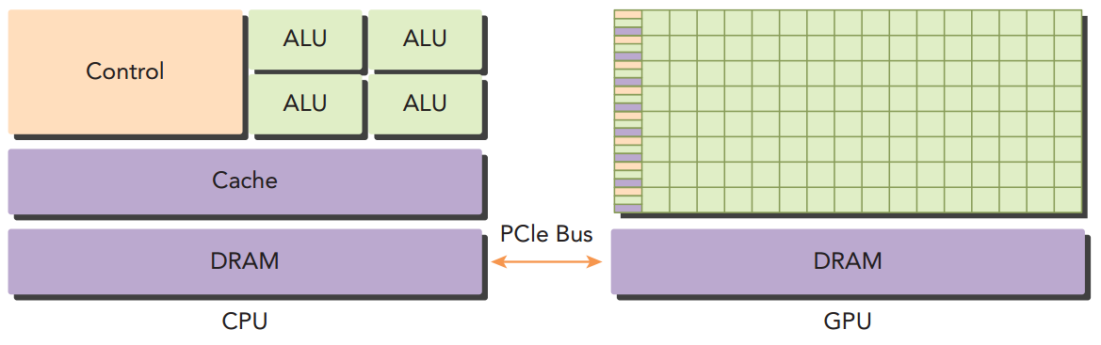
Heterogeneous Architecture

Slide 4
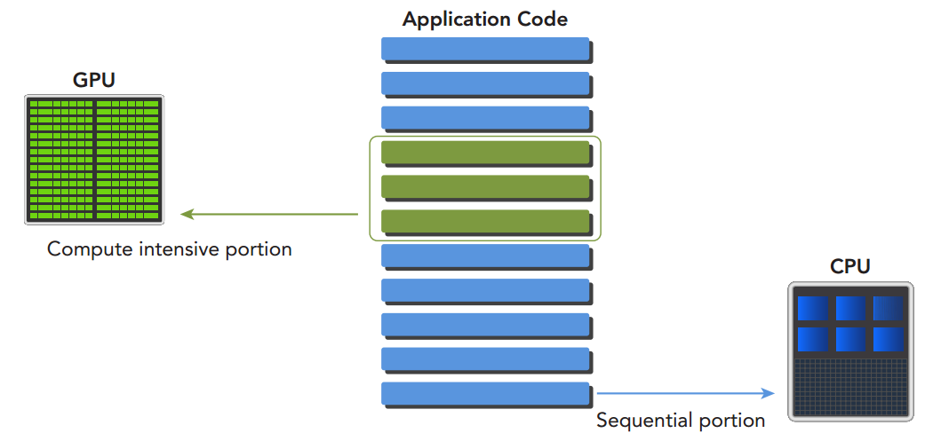
Heterogeneous Architecture
A heterogeneous application consists of two parts: ➤ Host code ➤ Device code Host code runs on CPUs and device code runs on GPUs.

Slide 5
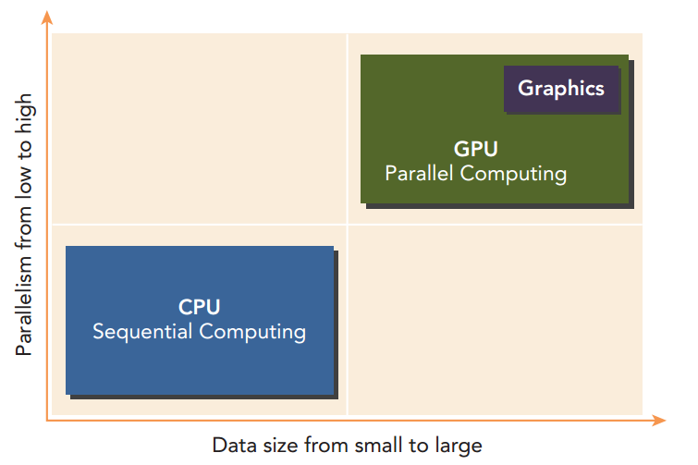
Paradigm of Heterogeneous Computing

Slide 6



Platforms for Heterogeneous Computing

Slide 7

Platforms for Heterogeneous Computing

Slide 8
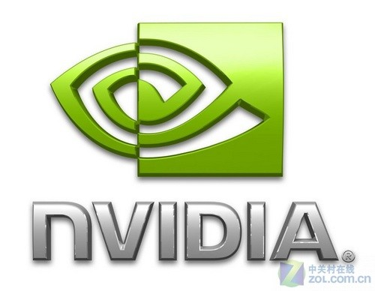
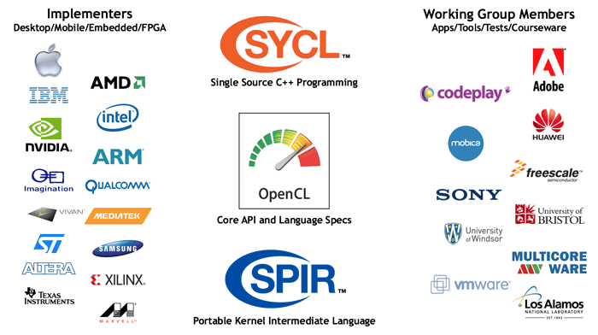
Platforms for Heterogeneous Computing
Ecosystem

Slide 9
Platforms for Heterogeneous Computing
How to choose?

Slide 10
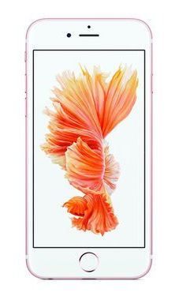

Platforms for Heterogeneous Computing
How to choose?
performance
portability

Slide 11
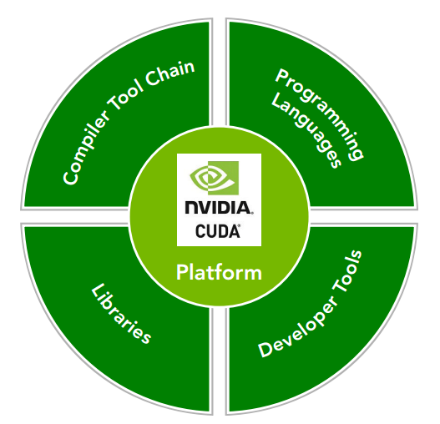
CUDA Platforms for Heterogeneous Computing
C fortran python Java OpenAcc
nvcc,ptx
cuFFT, cuBLAS,CULA,
cuRAND,NPP,Thrust
…
Nsight eclipse edition,
Nsight, nvvp, cuda-gdb, cuda-memcheck

Slide 12
CUDA Platforms for Heterogeneous Computing
GeForce ➔ GTX The ultimate GPU for gamers
Tesla ➔ supercomputing solutions
Quadro ➔ Quadro Professional Workstation Solutions
Tegra ➔ The World's Fastest Mobile Processors
NVIDIA Processors and how to choose GPU?

Slide 13
CUDA Platforms for Heterogeneous Computing
GeForce ➔ GTX The ultimate GPU for gamers
Inexpensive
High Performance
Disadvantages
NVIDIA Processors and how to choose GPU?

Slide 14
Thanks

